Slide 1




Back to School Night 2022-2023
Jeffery A. Voyles– CLIMB Program

Slide 2
About ME
Mr. Voyles
Masters: Azusa Pacific University
Bachelors: California Baptist University
Classes: Science; Workability; Life Skills

Slide 3

CLIMB Program
Connecting Learning, Independence and Mindfulness for Broncos
Provide a typical high school schedule to students with unique academic, social, and behavioral needs
Provide access to rigorous curriculum that is modified to meet all students' needs

Slide 4
Why?
Wider variety of social interactions
Opportunity to practice key social, behavioral and executive functioning skills
Unique teaching styles, experience, and insite provided by each of the three teachers
More individualized instruction and a wider breadth of content

Slide 5

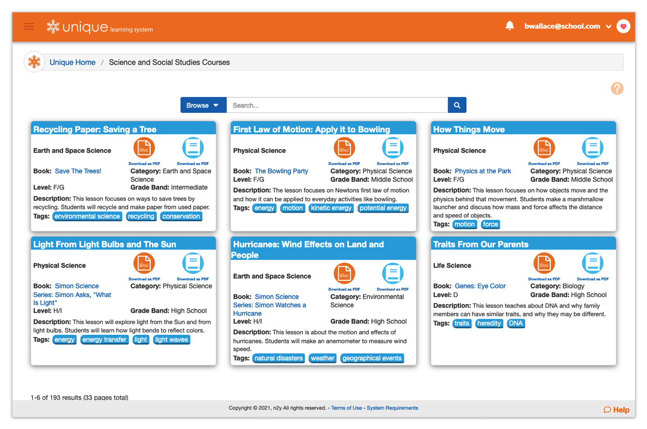
Science Foundations:
Unique Learning Systems (Periods 1, 3, 4)
Explore the NATURAL WORLD
n2y’s science courses for intermediate, middle, and high school help students meet the rigor outlined in the Next‑Generation Science Standards. Along with standards-based content, teaching resources and supplemental tools support mastery of concepts through state extended standards.
Biology
Earth and Space Science
Environmental Science
Life Science (Biology)
Physical Science

Slide 6
Study Skills/Life Skills
(period 5)
"Homeroom"
IEP Goals
Functional and Life Skills
Social Skills
Community-Based Instruction
Access to visual and performing arts
Vocational tasks and assessments

Slide 7

Workability
(Periods 5 & 7)
Special education is designed to prepare students for life beyond the classroom setting. The teaching of vocational skills is a part of the educational process to prepare the student for real life experiences.

Slide 8
After School Events
There are many school events taking place, check out the high school calendar on the Vista Murrieta webpage.
If you would like your child to attend an event (e.g. sport event, dance, play, music event, etc.) with a chaperone please contact a CLIMB teacher ahead of the event and we will see if we are able to attend that event with your child.
These events usually have limited tickets/seats, so getting ahead of it will help a lot as well as trying to make sure we are able to attend with our schedules.
Parents will still be responsible for paying for their child's ticket as well as transportation to and from the event.

Slide 9

Three points of contact
As you know, we have 3 CLIMB teachers (and a number of amazing aides). We keep one another up-to-date on all of the students in our program. You are welcome to contact any of the three CLIMB teachers with any questions or concerns but know that your child’s case manager will handle the IEP. You can also contact teachers through the Parent Portal. Our teachers include:
Mrs. Allen | Mrs. Fung | Mr. Voyles
serneste@ murrieta.k12.ca.us x6541 | cfung@ murrieta.k12.ca.us x6516 | jvoyles@ murrieta.k12.ca.us x6539

Slide 10
Reminder
Monday | Tuesday | Wednesday | Thursday | Friday
A/B | A/B | Late Start – A/B | A/B w/ Office Hours | A/B
School day: 8:15-3:15 | School day: 8:15-3:15 | School day: 9:15-3:15 | School day: 8:15-3:15 | School day: 8:15-3:15
Please let us know if you have any questions, concerns, or need help, we are a TEAM!
This school year started that all the high schools in the district are following. It's kind of confusing but give it a little time and we'll all have it figured out! :) Please follow the calendar provided on the Vista Murrieta High School website to keep track of “A” days, “B” days, late starts, holidays, etc. The days alternate between A and B typically with the occasional rally day, one lunch, finals schedule, etc.
As mentioned in our email to parents the first week of school, we operate 15 minutes ahead of the school start and end times to assist with transitions.

